Slide 1
programming
ERASMUS +

Slide 2
What is programming?
Programming is the art of making a computer do what you want it to do.
A computer program is simply a set of instructions to tell a computer how to perform a task.
Programming languages are used to write programs

Slide 3
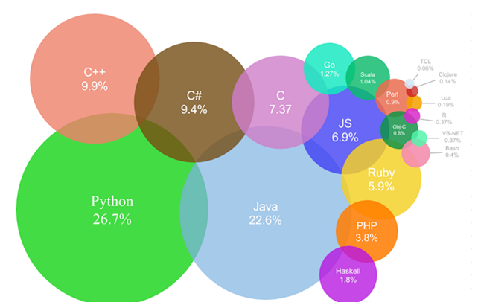
programming language

Slide 4
Some programming languages (like java or c++) require the code to be compiled (translated to binary) before it can be started.
Others (like javascript) are interpreted, meaning that each command is translated separately when the program is started.

Slide 5
Languages that look like “machine code” (e.g. 82A8: jsr r5) are used for…
Writing games
Writing application programs (like Excel)
Other languages look like English (“high level,” e.g., PRINT “HI”)
Logo
JavaScript
flowchart symbol

Slide 6
some examples of an instruction to print the word HI
Logo PR [HI]
JavaScript alert(“HI”);
FORTRAN PRINT “HI”
BASIC PRINT “HI”
COBOL DISPLAY ‘HI’.
C++ printf(“HI”);
Pascal WRITELN(‘HI’);
Assembly XPRNT MESSAGE1
Language MESSAGE1 DC ‘HI’

Slide 7
programming language

Slide 8
About Scratch:
Scratch is designed to be fun, educational, and easy to learn.
Scratch is a free programmable toolkit that enables kids to create their own games, animated stories, and interactive art and share their creations with one another over the Internet.
We can learn from Scratch: important computational ideas, think creatively, to reason systematically.

Slide 9
Scratch projects are made up of a stage and objects called sprites.
The stage is where you see your stories, games and animations come to life.
Sprites move and interact with one another on the stage

Slide 10
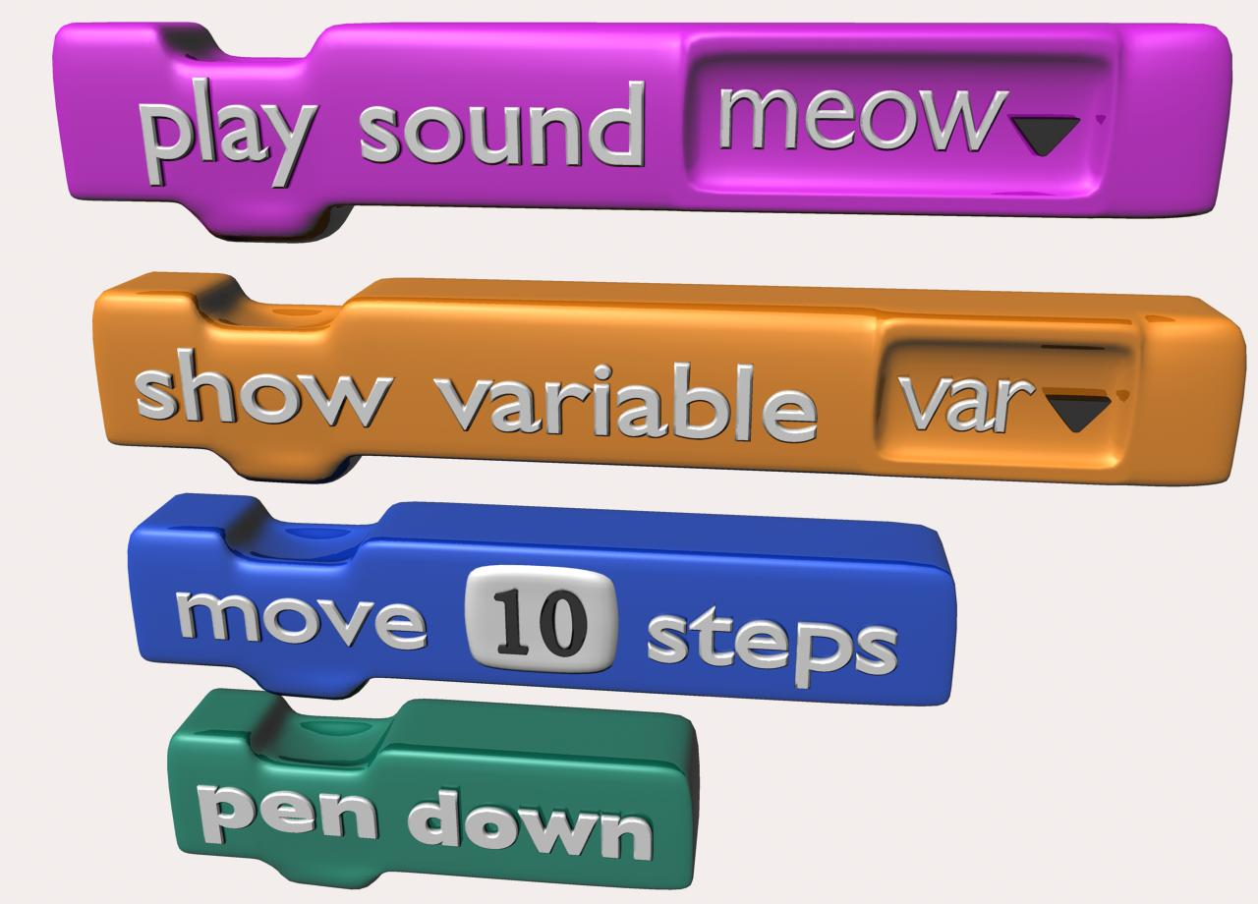
Blocks are puzzle-piece shapes that are used to create code in Scratch.
The blocks connect to each other like a jigsaw puzzle, where each data type has its own shape and a specially shaped slot for it to be inserted.
Series of connected blocks are called scripts

Slide 11
http://scratch.mit.edu
experiment and make program yourself

